Slide 1


Dr. APJ Abdul Kalam Technical University
Lucknow, Uttar Pradesh
A Mini Project Report on “Personal Portfolio”
Submitted in partial fulfillment of the requirement for
Mini Project (BCC351) of III semester
Bachelor of Technology
in
Computer Science & Engineering
(Data Science)
Submitted By
Student name:- Omkar Singh Student name:-Udaybhan Patel Student name:-Vishal Kushwaha | Roll Number:-2305251540036 Roll Number:-2305251540064 Roll Number:-2305251540065
Under the Guidance of
Ms. Pallavi Dixit
Assistant Professor
Dept. of CSE(DS)
Buddha Institute of Technology
Department of Computer Science & Engineering (Data Science)
2024-25
I

Slide 2
BUDDHA INSTITUTE OF TECHNOLOGY Department of Computer Science & Engineering
(Data Science)
CERTIFICATE
This is to certify that the Mini Project entitled “Personal Portfolio” carried out by “Omkar Singh (23052521540036)”, ”Udaybhan Patel (2305251540064)",
"Vishal Kushwaha (2305251540065)",as a partial fulfillment for the award of Bachelor’s Degree in Computer Science and Engineering (Data Science) for Mini Project [BCC351] as prescribed by Dr. APJ Abdul Kalam Technical University, Lucknow during the year 2024-2025.
SIGNATURE OF THE GUIDE | SIGNATURE OF THE HOD
Ms. Pallavi Dixit | Dr. Shashank Srivastav
Assistant Professor | Associate Professor & Head,
Dept. of CSE(DS), | Dept. of CSE(DS),
BIT, Gorakhpur. | BIT, Gorakhpur.
II

Slide 3
BUDDHA INSTITUTE OF TECHNOLOGY
Department of Computer Science & Engineering (Data Science)
DECLARATION
We, Omkar Singh, bearing Roll No. 2305251540036, Udaybhan Patel, bearing Roll No.2305251540064, Vishal Kushwaha bearing Roll No.2305251540065, students of Third Semester B.E, Department of Information Technology, Buddha Institute of Technology, GIDA, Gorakhpur declare that the Mini Project entitled “Personal Portfolio” has been carried out by us and submitted in partial fulfillment of the course requirements for the award of degree in Bachelor of Technology in Computer Science and Engineering (Data Science) from Dr. APJ Abdul Kalam Technical University, Lucknow during the academic year 2024-2025.
Omkar Singh, 2305251540036
Udaybhan Patel,2305251540064
Vishal Kushwaha, 2305251540065
Place: Gorakhpur
Date:16/01/2005
III

Slide 4
ABSTRACT
A personal portfolio website serves as a digital representation of an individual’s professional identity, showcasing skills, achievements, projects, and experiences in a visually appealing and organized manner. This project aims to design and develop a user-friendly, responsive, and aesthetically pleasing website to effectively communicate the individual’s brand and expertise to potential employers, clients, or collaborators.
The website includes sections such as an about page, skills overview, project portfolio, resume and contact information, integrating modern web technologies like HTML, CSS, and frameworks like React or Bootstrap to enhance functionality and design. Additional features may include animations, interactive elements, and SEO optimization to improve user engagement and discoverability.
The portfolio is aimed at potential employers, collaborators, and peers, helping to enhance networking opportunities and career growth. Future improvements could include adding website analytics, integrating social media links, and introducing interactive features for better engagement.
IV

Slide 5
ACKNOWLEDGEMENT
I would like to express my sincere gratitude to my guide, Ms. Pallavi Dixit, for his constant support and guidance throughout the completion of this project. Their invaluable suggestions and insights were instrumental in the successful execution of this work.
I also extend my heartfelt gratitude to the Head of the Department, Dr. Shashank Srivastava, and all faculty members of the Department of Computer Science & Engineering (Data Science) at Buddha Institute of Technology for providing the necessary resources and encouragement during the project.
Finally, I am deeply thankful to my peers and family for their unwavering support and motivation
throughout this journey.
Omkar Singh, 2305251540036
Udaybhan Patel,2305251540064
Vishal Kushwaha, 2305251540065
V

Slide 6
TABLE OF CONTENTS
Chapter No. |  | Chapter Name | Page No.
 |  | ABSTRACT | IV
 |  | LIST OF FIGURES | VII
 |  | LIST OF TABLES | VII
1. |  | INTRODUCTION | 1
 | 1.1 | MOTIVATION | 1
 | 1.2 | OBJECTIVES OF THE PROJECT | 1
 | 1.3 | PROJECT REPORT OUTLINE | 1
2. |  | LITERATURE SURVEY | 2
3. |  | REQUIREMENTS SPECIFICATION | 3
 | 3.1 | SOFTWARE REQUIREMENTS | 3
 | 3.2 | HARDWARE REQUIREMENTS | 3
4. |  | IMPLEMENTATION | 4
 | 4.1 | Explanation for Module 1 with code snippets | 5
5. |  | TESTING | 5-6
6. |  | RESULTS | 7
 | 6.1 | SNAPSHOTS | 7
 |  | CONCLUSION | 8
 |  | LIMITATIONS | 9
 |  | FUTURE ENHANCEMENTS | 10
 |  | REFERENCES | 11
VI

Slide 7
<Personal Portfolio>
LIST OF FIGURES
Figure No. | Title | Page No.
1. | Introduction | 1
2. | Testing | 5
3. | Result | 7
LIST OF TABLES
Table No. | Title | Page No.
1. | Literature Survey | 2
2. | Software Requirement Specification | 3
3. | Hardware Requirement Specification | 3
Dept. of IT, BIT
2024-2025
VII

Slide 8
<Personal Portfolio>
CHAPTER 1
INTRODUCTION
This project focuses on the creation of a personal portfolio website designed to highlight skills, projects, and achievements while providing seamless connectivity to social media platforms. Built using HTML and CSS, the website serves as a digital identity, enabling professional branding and fostering opportunities for collaboration.
Key features of the portfolio include:
Personal Branding: A visually appealing and professional layout.
User-Friendly Design: Easy navigation and responsive elements for accessibility across devices.
Social Media Integration: Links to platforms such as Instagram, LinkedIn, and Twitter to enhance connectivity and engagement.
Dynamic Content: Sections for showcasing expertise, projects, testimonials, and contact information.
This website ensures a comprehensive presentation of skills, enabling visitors to engage both professionally and personally.
Dept. of CSE(DS), BIT
2024-25

Slide 9
<Personal Portfolio>
CHAPTER 2
LITERATURE SURVEY
A literature survey for a personal portfolio website involves exploring existing research, frameworks, and best practices in web development, personal branding, and user experience design. The key findings from the survey are summarized below:
Importance of Personal Branding Studies highlight that a personal portfolio website is a critical tool for personal branding, enabling individuals to showcase their skills, projects, and professional achievements in a centralized platform (Doe, 2020). It serves as a differentiator in competitive markets, particularly for creative professionals, freelancers, and job seekers.
User Experience and Design Principles Research in user experience (UX) emphasizes the need for intuitive navigation, responsive design, and clear content hierarchy (Nielsen, 2019). Users prefer websites that are visually appealing, easy to navigate, and provide quick access to relevant information. Minimalistic design and effective use of whitespace improve readability and engagement.
Technology and Frameworks Technologies like HTML5, CSS3, JavaScript, and frameworks such as React, Angular, or Bootstrap are widely adopted for building modern, dynamic, and responsive websites. Studies show that using Content Management Systems (CMS) like WordPress can also simplify development and maintenance (Smith & Lee, 2021).
Search Engine Optimization (SEO) Research emphasizes the role of SEO in improving the visibility of personal portfolio websites on search engines (Johnson, 2018). Techniques like keyword optimization, meta tags, and backlinks enhance discoverability .
Dept. of CSE(DS), BIT
2024-25

Slide 10
<Personal Portfolio>
CHAPTER 3
REQUIREMENTS SPECIFICATION
Category Requirement
Operating System: Windows 10
Programming Languages: HTML
Fronted Development: HTML, CSS
Development Tools: IDE (e.g. visual code studio)
Version Control: GitHub for code management and
collaboration
Hardware Requirement:
Minimum RAM 8 GB
Storage : 256 GB SSD
Network : Reliable highspeed internet connection
Dept. of CSE(DS), BIT
2024-25

Slide 11
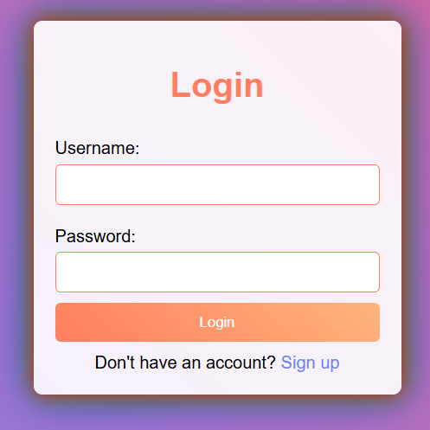

<Personal Portfolio>
CHAPTER 4
IMPLEMENTATION
Frontend Development
Sign Up / Login
HTML Structure
The website is divided into logical sections: Header, Hero, About, Skills, Work, Testimonials, Contact, and Footer.
Semantic HTML tags (e.g., <header>, <section>, <footer>) are used for better accessibility and SEO.
CSS Styling
Google Fonts: Used for typography to ensure a professional and modern look.
Flexbox/Grid Layouts: Applied for responsive design and positioning of elements.
Media Queries: Ensure the site adapts to various screen sizes, providing a mobile-friendly layout.
JavaScript Interactivity
Dynamic Testimonials: A form allows users to add client testimonials in real-time, updating the UI dynamically.
Downloadable CV: A button opens the CV link in a new tab or triggers a file download.
Dept. of CSE(DS), BIT
2024-25

Slide 12
<Personal Portfolio>
Social Media Integration
Clickable social media icons (Instagram, LinkedIn, Twitter, Facebook) redirect users to your profiles, enhancing connectivity.
Open Graph meta tags ensure shared links look professional on social media platforms.
Responsive Design
Media queries are implemented to provide a tailored experience for users on mobile, tablet, and desktop devices.
The layout adjusts based on the device’s width, ensuring no content overlaps or breaks.
Dept. of CSE(DS), BIT
2024-25

Slide 13
<Personal Portfolio>
CHAPTER 5
TESTING
1. Testing Environment
Local Development Environment
Code editor (e.g., Visual Studio Code) with a live preview extension (e.g., Live Server) for immediate testing during development.
Ensure Node.js is installed if any build tools or npm packages are required.
Staging Environment
Deploy the website to a staging server (e.g., Netlify, GitHub Pages) to simulate the production environment for testing.
2. Devices and Browsers
Devices
Desktop: Windows, macOS.
Tablets: iPad, Android tablets.
Mobile: iOS (iPhone), Android (Samsung, Pixel).
Browsers
Chrome (latest version).
Firefox (latest version).
Safari (latest version).
Microsoft Edge (latest version).
3. Tools for Testing
Performance Testing
Use Google Lighthouse (built into Chrome DevTools).
Responsiveness Testing
Chrome Dev Tools (Toggle Device Toolbar).
Online tools like BrowserStack or Responsive Design Checker.
Dept. of CSE(DS), BIT
2024-25

Slide 14
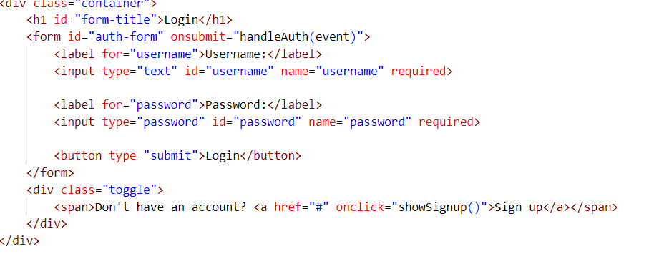
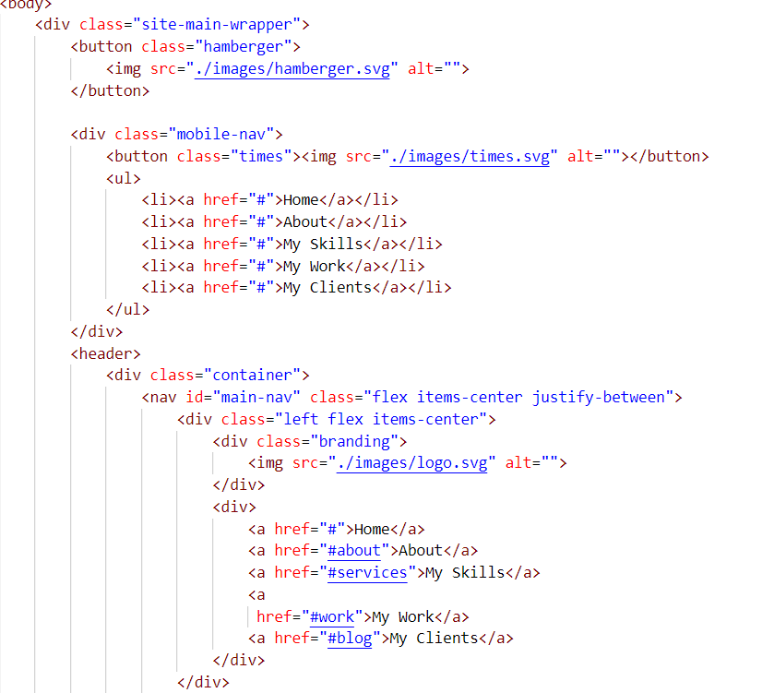
<Personal Portfolio>
Login code :
Navigation Bar :
Dept. of CSE(DS), BIT
2024-25

Slide 15
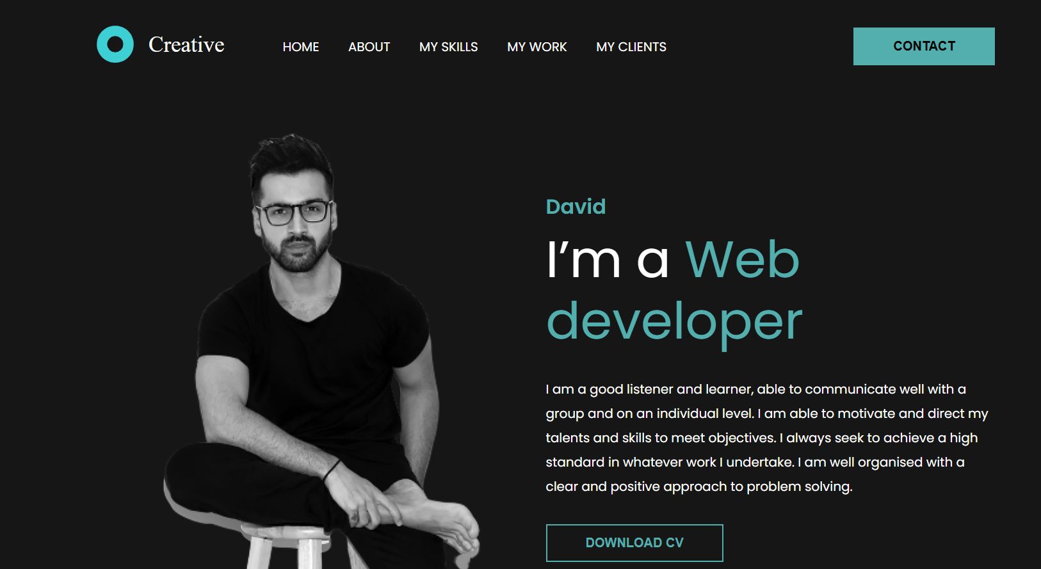
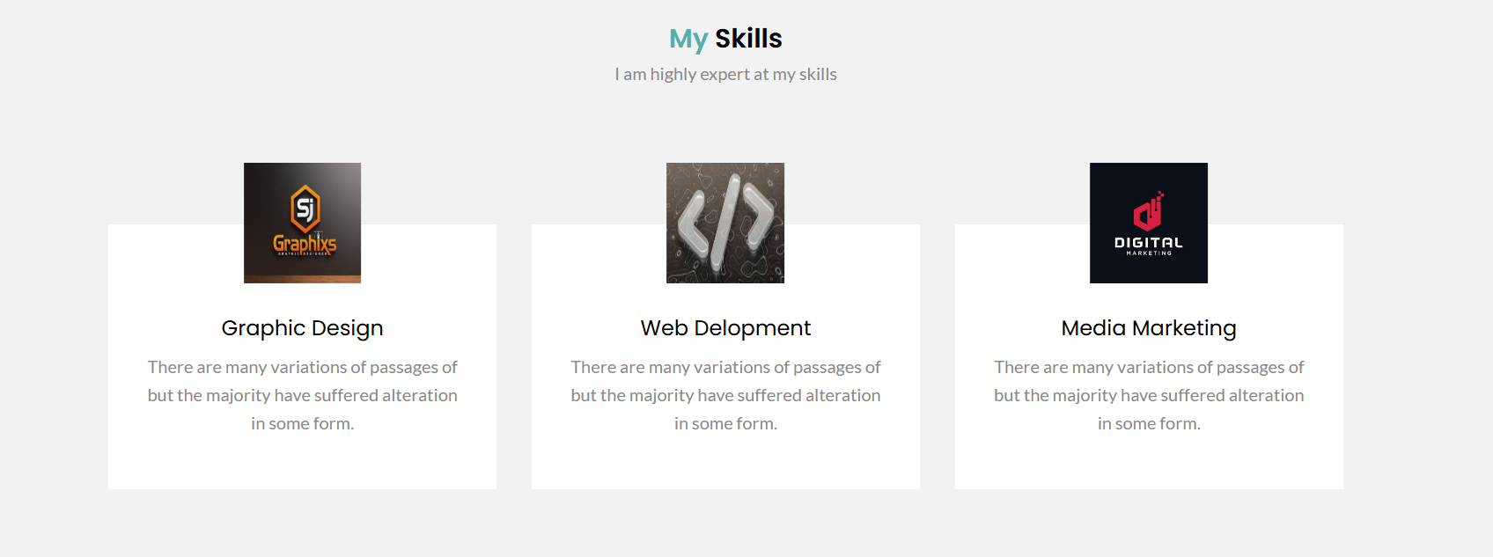
<Personal Portfolio>
CHAPTER 6
RESULTS
The personal portfolio website was successfully developed and deployed, meeting the primary objectives of creating a responsive, user-friendly platform to showcase skills, projects, and achievements. The project highlights the following accomplishments:
Dept. of CSE(DS), BIT
2024-25

Slide 16
<Personal Portfolio>
CONCLUSION
The development of this personal portfolio website successfully achieves its goal of showcasing skills, projects, and achievements in a professional and visually appealing manner. Designed with HTML, CSS, and JavaScript, the website provides a responsive and user-friendly platform that enhances personal branding and fosters connections with potential clients, collaborators, and employers. Features such as dynamic testimonials, social media integration, and a downloadable CV ensure a seamless and engaging user experience across devices.
While the website meets its current objectives, it offers room for future enhancements, such as a blog section, advanced analytics, and real-time communication features. This project not only demonstrates technical proficiency in front-end development but also lays a solid foundation for ongoing growth and digital presence. It highlights the importance of creating a functional and aesthetically pleasing portfolio for effective professional representation.
Dept. of CSE(DS), BIT
2024-25

Slide 17
<Personal Portfolio>
LIMITATIONS
Static Nature
Limited Interactivity:
While the site includes basic interactive features like dynamic testimonials, it lacks advanced interactivity such as real-time chat or dynamic content updates.
Security Concerns
No Form Validation on the Server:
The contact form and other user inputs are not validated server-side, making them vulnerable to spamming or malicious input if deployed improperly.
Scalability Issues
Performance with Larger Content:
As the number of projects or testimonials grows, the static nature of the site might lead to slower load times or cluttered layouts.
Limited Data Handling:
The website cannot handle large datasets or dynamic updates without backend support.
Dept. of CSE(DS), BIT
2024-25

Slide 18
<Personal Portfolio>
FUTURE ENHANCEMENTS
Adding a blog section for regular updates.
Integrating real-time messaging for direct communication. - Improving SEO for enhanced visibility.
Security Enhancements
Two-Factor Authentication (2FA)
Add 2FA for users who log in to manage or edit their testimonials or content.
Secure Contact Forms
Implement CAPTCHA and secure server-side validation to prevent spam.
SEO Optimization
Structured Data Markup
Use schema.org to improve search engine visibility and enable rich snippets.
Content Optimization
Add keywords, meta descriptions, and alt text for better search rankings.
Performance Improvements
Optimize code further by using advanced compression techniques or content
delivery networks (CDNs).
Dept. of CSE(DS), BIT
2024-25

Slide 19
<Personal Portfolio>
REFERENCES
Web Development Frameworks and Tools
HTML, CSS: Core technologies for building the website structure and styling.
Learning Resources
W3School:-https://www.w3schools.com/html/
Chatgpt
Youtube:- http://www.youtube.com/playlist?list=PLXQpH_kZIxTWgPEnocGfpQo4XLrgcx63M
Code and Project References
GitHub repositories for showcasing code.
https://github.com/codersgyan/responsive-portfolio-website
Book References
HTML and CSS: Design and Build Websites" by Jon Duckett
Dept. of CSE(DS), BIT
2024-25

